Slide 1

Department Operation
Comprehensive operational analytics for organization-wide insights into workforce, budget, and projects

Slide 2

Project Overview
Project Launch
Platform
Started November 16, 2025
Microsoft Fabric & Power BI Desktop
Project Lead
Individual Aspirant Data Analyst
Designed to provide operational overview of each department using integrated datasets and advanced analytics, enabling comprehensive departmental analysis through merged data sources.

Slide 3
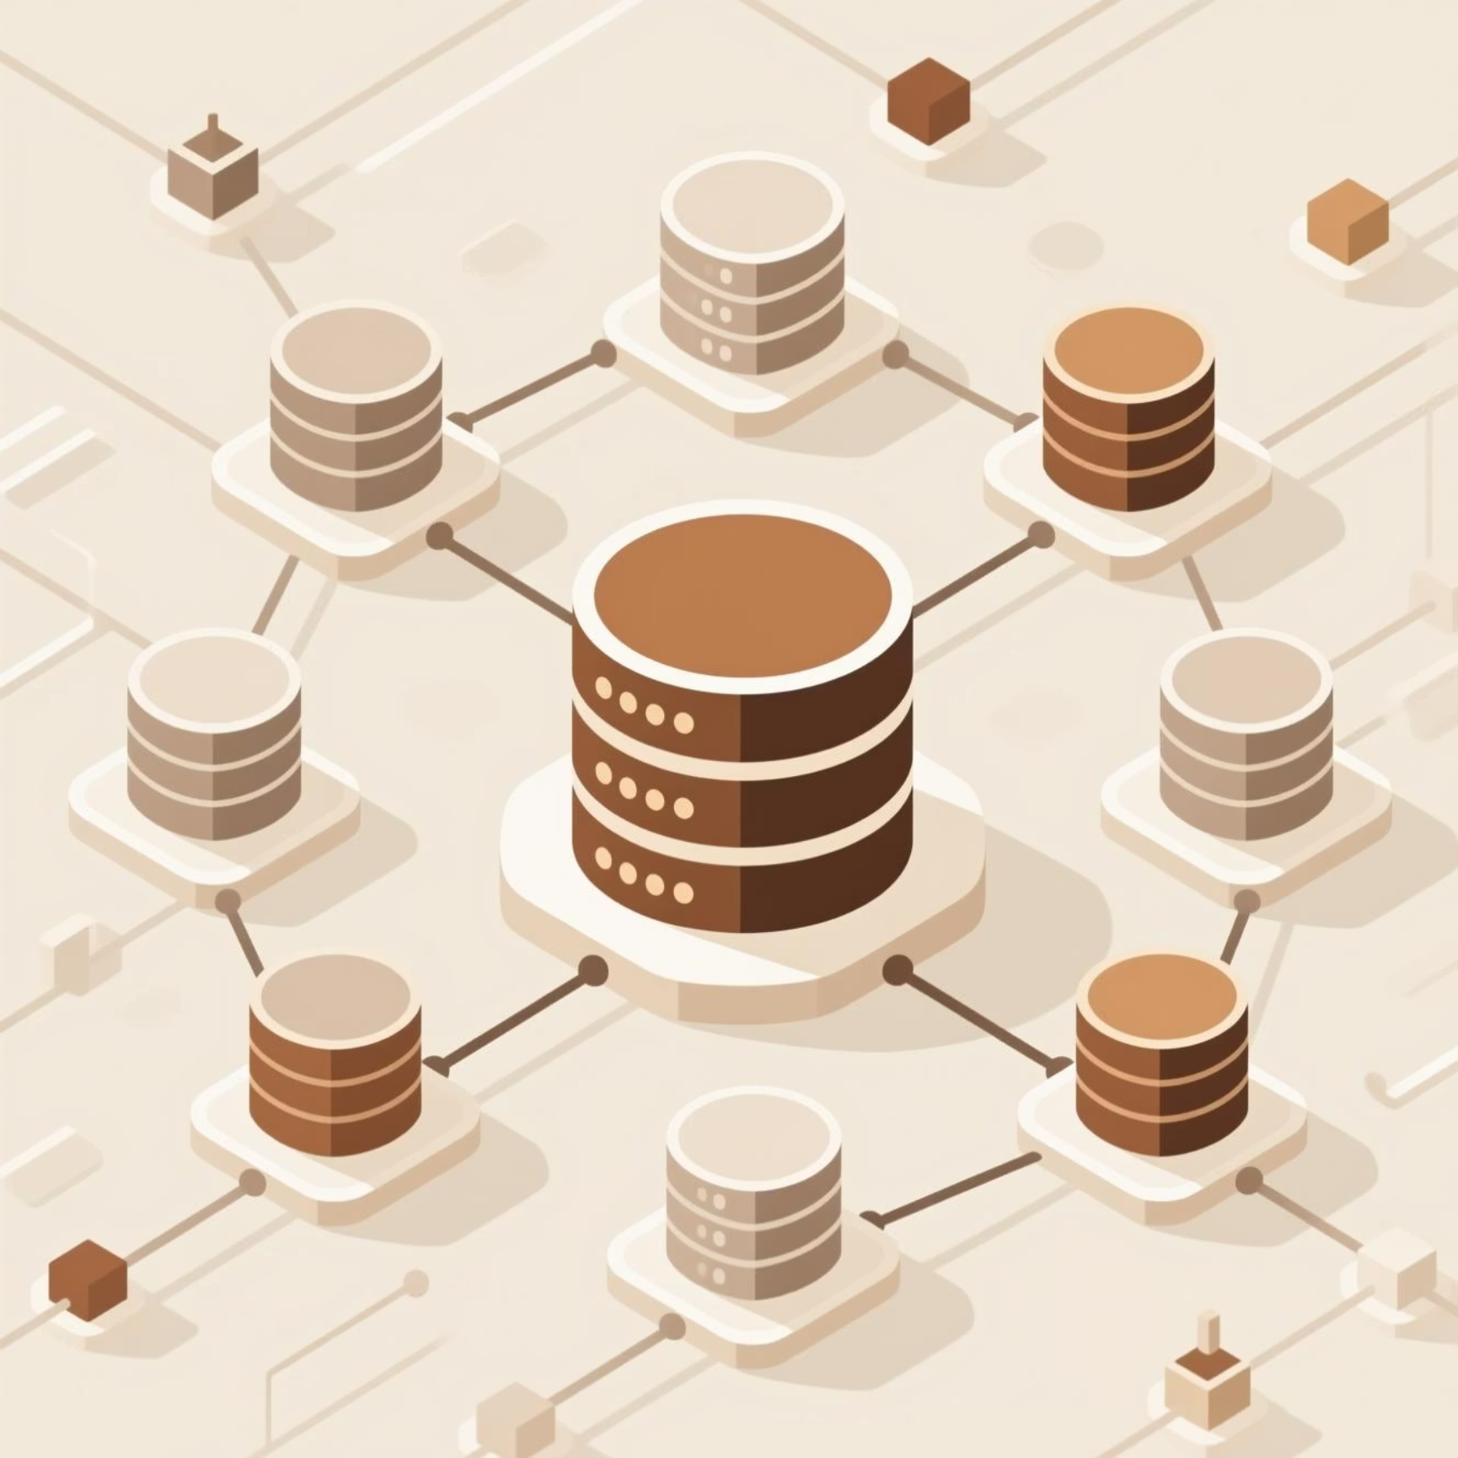
Data Integration Strategy
Source Data
Integration Process
Six CSV files merged for unified reporting:
Data combined using SQL queries and views in Fabric, ensuring unified structure for comprehensive reporting and analysis.
Employee records
Department information
Project details
Assignment data
Head_Shots images for profiles

Slide 4
SQL Views Architecture
1
2
3
Department View
Cost View
Semantic Model Tables
Combines employee, department, project, and assignment data with project statuses (Upcoming/Completed). Uses CTE for project_status calculation.
Aggregates budgets, salary costs, and project costs per department, providing operational financial insights for decision-making.
Three core tables: department (view), cost (view), and Head_Shots (images) for downstream analysis.

Slide 5

Semantic Model Structure
The semantic model comprises three interconnected tables enabling comprehensive analysis. Relationships connect employees, departments, projects, and headshots for seamless data flow into Power BI visualizations.

Slide 6

Power BI Dashboard Features
Project Distribution
Financial KPIs
Donut charts showing project allocation across departments
Cards displaying total capital and project budgets
Employee Profiles
Dynamic Filters
Headshot cards with personal details, role, and compensation
Panels for Employee_ID, Department_Name, and Status
Department Metrics
Budget Analysis
Tables showing goals, costs, budgets, and capital
Bar charts for project budgets by department and project

Slide 7

Key Metrics Tracked
6
3
2
Data Sources
Core Tables
SQL Views
CSV files integrated
In semantic model
Department & Cost

Slide 8




Automated Data Pipeline
Data Sources
Data Flow Gen2
Six CSV files with employee, department, and project data
Automated transformation and loading process
Scheduled Refresh
Live Dashboards
Maintains up-to-date reporting across Power BI
Real-time insights and visualizations
One data pipeline ensures scheduled refresh using Data Flow Gen2 and the semantic model for continuous data availability.

Slide 9

Key Insights & Impact
Comprehensive Analysis
Departmental financial health monitoring
Employee compensation tracking
Project execution oversight
Resource allocation optimization
Decision Support
Enables data-driven decisions for resource allocation and operational improvements across all departments.

Slide 10

Project Success
Unified Data Platform
Actionable Insights
Successfully integrated six data sources into cohesive semantic model
Comprehensive dashboards supporting strategic decision-making
Automated Reporting
Scheduled refresh ensures real-time operational visibility

